Slide 1
Travel Policy & Procedures Review
Fall 2018

Slide 2
Abbreviations Used in this Presentation
DOAS - Department of Administrative Services (State of Georgia)
SAO - State Accounting Office (State of Georgia)
BOR – Board of Regents
USG - University System of Georgia
KSU - Kennesaw State University
OFA - Office of Finance and Accounting (Kennesaw State University)

Slide 3
Office of Finance and Accounting (OFA) Travel Team Members
Sandy Cagliani
Director of Accounting
& Finance
Heather Mead
Travel Administrator
Catherine Chesser
Travel Accountant
Beverly Dittman Travel Accountant
Lois Leahy
Travel Accountant
Sherry Reid
Travel Accountant
Sandra Walton Travel Accountant

Slide 4
WellStar College of Health and Human Services Business Operations
Sandy Parr (retiring 09/28/18)
Business Affairs Manager
sparr@kennesaw.edu
470-578-6782
Stephanie Vaughn
Travel & Purchasing Card
svaugh41@kennesaw.edu
470-578-2433

Slide 5
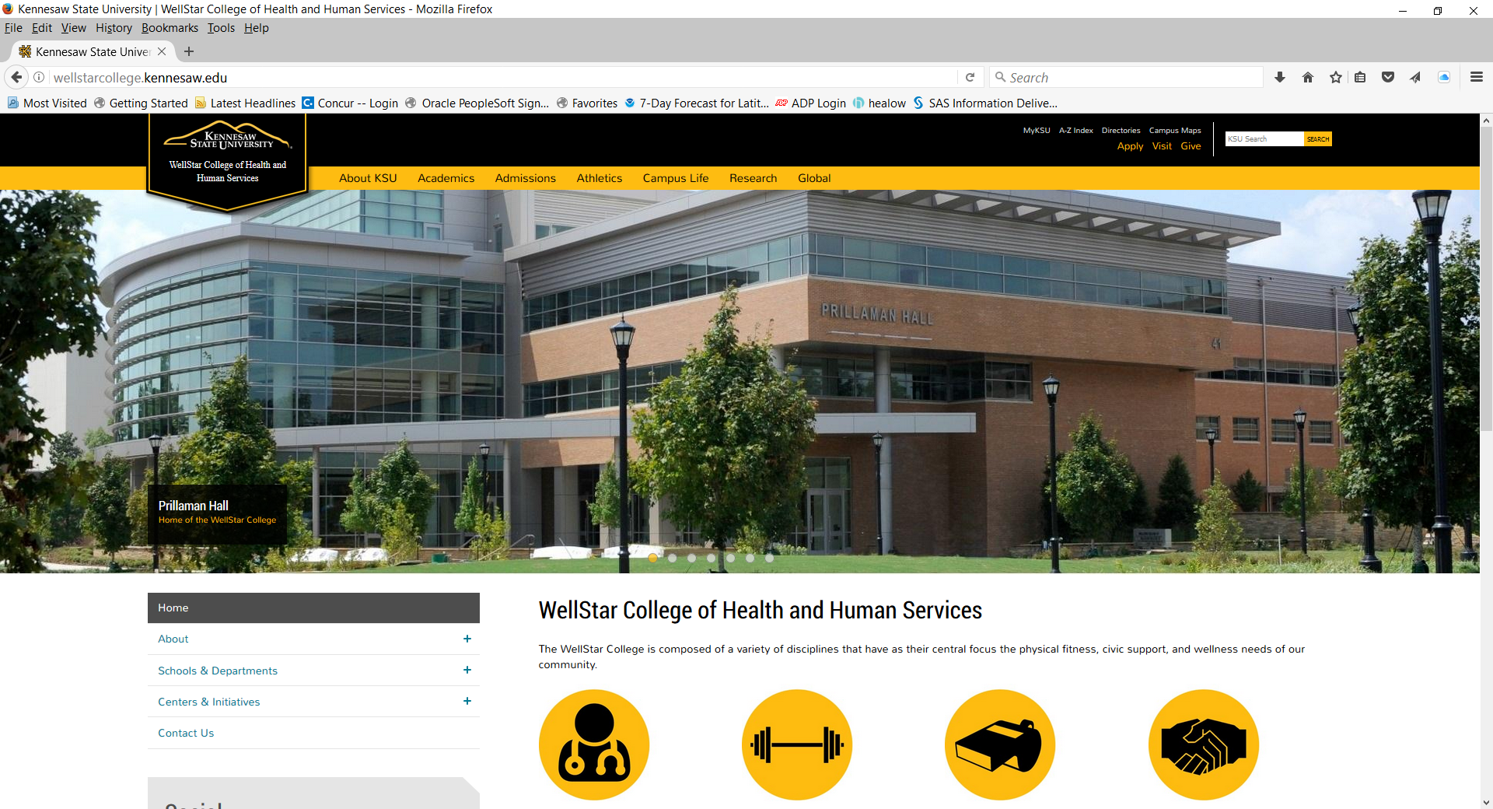
wellstarcollege.kennesaw.edu

Slide 6
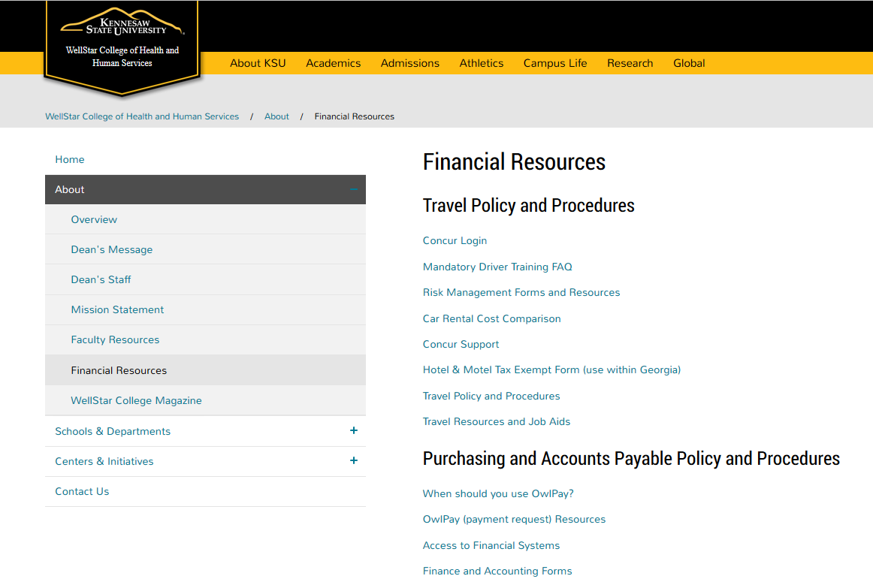

Slide 7
Concur

Slide 8
If you are having trouble logging into Concur…
Are you using the correct User Name for Concur?
NetID@ksu

Slide 9
If you are still having trouble…
Contact your Admin. Associate
-or- Contact Stephanie Vaughn
svaugh41@kennesaw.edu
-or-
Email the KSU Travel Team
travel@kennesaw.edu

Slide 10
Travel Request Tips & Policy Reminders

Slide 11
KSU Travel Policy

Slide 12
Travel Requests
Per SAO, BOR, and KSU policies, Travel Requests are REQUIRED for all employee out-of-state, international, and in-state overnight travel.
Travel Requests must be completed, submitted, and FULLY APPROVED in the Concur system prior to any registration purchase and/or travel booking.
Travel Requests should be submitted no less than 14 days in advance of trip*
*There are a few exceptions to this rule – please ask

Slide 13
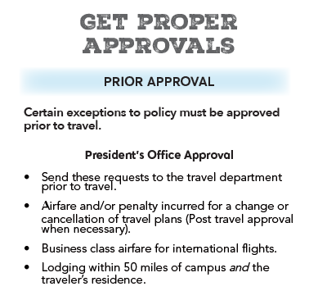
*NEW POLICY* Special Approvals from the President’s Office

Slide 14
Please remember to include the CONFERENCE NAME on your travel request!
Enter the conference name in the “Purpose” or “Comment” box please!

Slide 15
If any portion of your trip is being funded by another Department or Grant, please remember to include the additional Approvers to your request.

Slide 16
Question: What if I am going to be traveling for business but I am not going to claim any travel expenses for reimbursement?
Answer: If an employee is traveling on business but will NOT be claiming any travel expenses for reimbursement, a paper “Travel Request” form will need to be completed, signed, and submitted to Stephanie Vaughn for recordkeeping (email is fine).

Slide 17
Travel Request Form
Form is located under the Travel Resources and Job Aids link on the WCHHS Financial Resources webpage
Form must be signed by the employee AND their supervisor
Send copy of form to Stephanie Vaughn for recordkeeping (you do not need to send a copy to the Travel Dept.)
Keep original for your records

Slide 18
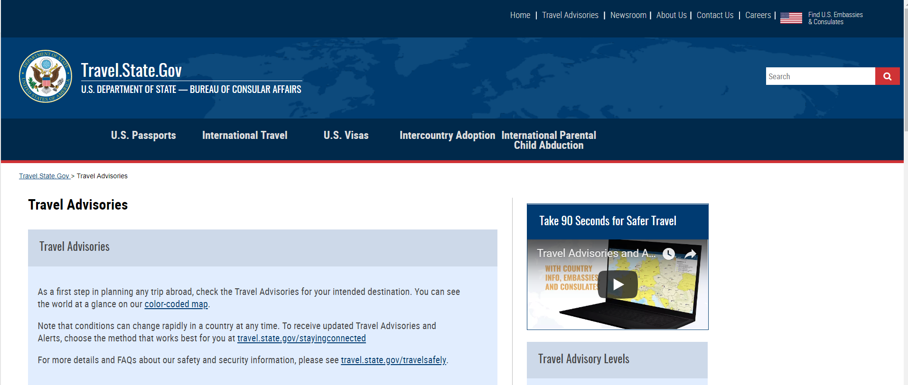
If you are planning to travel internationally on university business but at no cost to KSU
(ex: organization is paying all travel expenses)
please send an email to
Michael Sweazey
KSU Director of International Safety and Security
msweazey@kennesaw.edu

Slide 19
Booking Tips & Policy Reminders

Slide 20
Policy Reminder
Airfare and Rental Cars must be booked online using Concur, or by a travel agent at Travel, Inc.
Travel, Inc.
770-291-5190 or 877-548-2996
SOG@travelinc.com

Slide 21
Airfare Rules & Regulations
Select the LOWEST priced airfare that meets the approved itinerary (Tip: look for the green checkmark – this indicates that the airfare meets SAO/BOR policy requirements)

Slide 22
Airfare Rules & Regulations
A minimum 14 day advanced ticket purchase is required. If booking is less than 14 days prior to travel, written approval (email or memo) must be obtained from your supervisor PRIOR to booking.
If a trip is canceled after airfare is booked, an expense report is still required in order to charge the department for the unused airfare.
Baggage fees are reimbursable for the first checked bag only.
Baggage fees for excess weight are NOT reimbursable unless an appropriate business explanation is provided and approved by your supervisor.
Priority seating fees are NOT reimbursable.

Slide 23
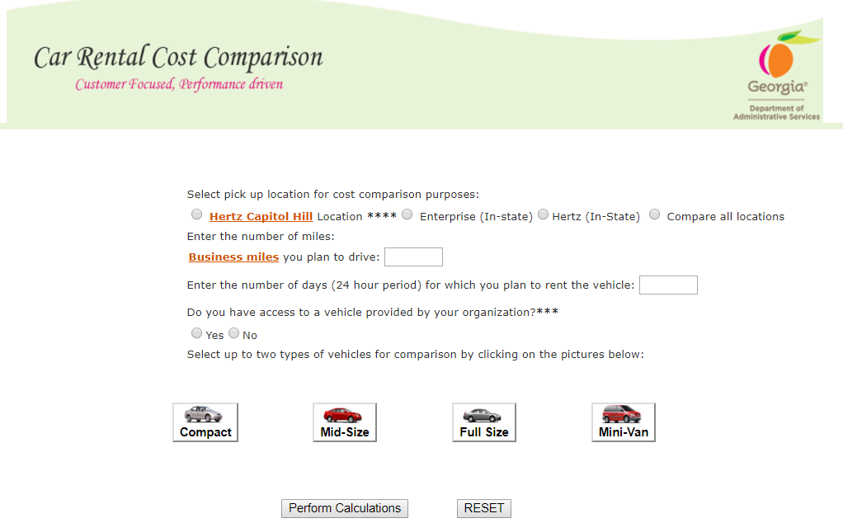
Car Rental Rules & Regulations
For business trips that will be an estimated 100 miles or more ROUND-TRIP, the Car Rental Cost Comparison Tool should be utilized to determine the most cost-effective means of transportation (rental car vs. personal car)
http://ssl.doas.state.ga.us/vehcostcomp/

Slide 24
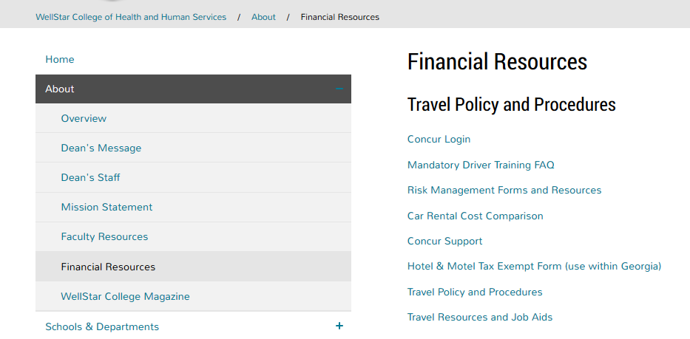

Slide 25
Car Rental Rules & Regulations
There are two MANDATORY contracts for rental cars for State employees:
All airport locations including Atlanta
All in-state/non-airport locations in Georgia
Policy Note: renting a vehicle from another vendor outside the Statewide vendor contract will require an approved waiver from DOAS (Form # SPD-N10005) prior to travel.

Slide 26
Car Rental Rules & Regulations
Approved rental car sizes:
Compact (Dodge Neon or similar)
Mid-Size (Chevy Cobalt or similar)
Full Size (Ford Taurus or similar)
Mini-Vans – for more than four employees

Slide 27
Policy Reminder
The State liability policy is only in effect while the employee is using the rented vehicle for official business. For this reason, personal use of the vehicle, including allowing friends or family members to ride in a State rented vehicle, is prohibited.

Slide 28
Hotel Rules & Regulations
Hotels can be booked without using Concur or Travel, Inc. for one of the following situations*:
The conference rate is cheaper than the Concur government rate
The hotel or resort cannot be reserved via Concur or by a travel agent at Travel, Inc.
*Tip: remember to add a comment to your expense report to explain why you booked your hotel without using Concur and/or Travel, Inc.

Slide 29
Hotel Rules & Regulations
Using a private residence for business lodging (e.g. “Airbnb”, “VBRO”, “HomeAway”, etc.) for DOMESTIC travel is prohibited and will NOT be reimbursed by the State – no exceptions.
We MAY be able to obtain approval for International Travel, but it must be approved by the State in advance. Please contact the Travel Team (travel@kennesaw.edu) for the pre-approval process.

Slide 30
Hotel Rules & Regulations
Overnight stay within Georgia:
Requires approval from direct supervisor (Tip: attach an approval email from your supervisor)
State employees are exempt from paying “hotel/motel” or “occupancy” tax while traveling within the state (Tip: don’t forget to download and print the “Hotel Tax Exempt Form” and bring it with you!)

Slide 32
Combining Personal Travel with State Business Travel

Slide 33
Combining Personal and Business Travel
Any personal time that will be taken before, during, or after a business trip must be approved by your supervisor BEFORE travel.
Dates (personal + business) should be entered on the TRAVEL REQUEST as well as a comment stating that personal time will be taken during the business trip
Attach Email approval from your supervisor
NEW policy (effective 07/01/18) If traveling by air, a cost-comparison showing “personal + business” airfare vs. “business-only” airfare must be attached to the Travel Request!
NOTE: If due diligence is not completed and cannot be proven after the fact, the employee’s reimbursement may be reduced from the reported amount.

Slide 34
Combining Personal and Business Travel
If an employee wants to add personal time to a business trip however, the airfare is more than the “business only” fare, it is preferred that the employee pays for the airfare out-of-pocket. The university will reimburse the employee for the business portion:
Employee contacts Travel, Inc. (770-291-5190) to book airfare (Tip: have your personal credit card ready)
Travel, Inc. will charge the employee’s personal credit card for the airfare and email the traveler a quote for the business portion of the trip
When the employee returns from the trip, the business airfare is entered as an “out of pocket” expense in Concur and the employee is reimbursed (Tip: include a copy of the airfare receipt or invoice that shows proof of payment using your personal credit card)

Slide 35
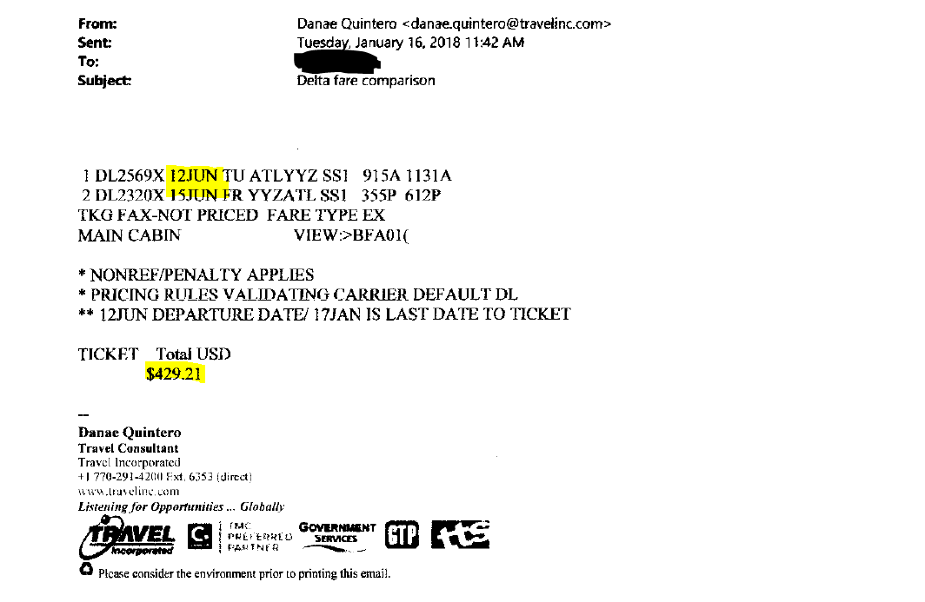
Example: “business only” quote (06/12 – 06/15)
$429.21

Slide 36
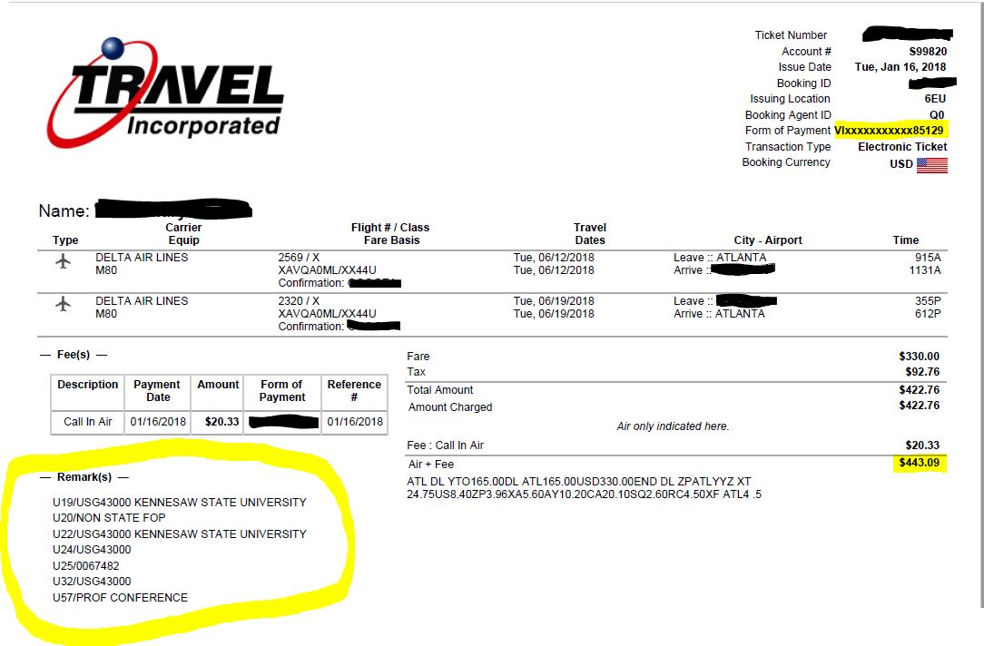
Example: personal + business quote (06/12 – 06/19)
$443.09

Slide 37
Question: What if I am going to DRIVE to a conference, but I am also going to use some personal time while traveling?
Answer: My best advice…
Drive your own vehicle and ask for mileage reimbursement at the Tier 2 rate.
(currently $0.18 per mile)

Slide 38
Remember…
Personal use of a State rented vehicle, including allowing friends and family to ride in a State rented vehicle, is prohibited.

Slide 39
Expense Reports

Slide 40
Expense Report Reminders
Attach a copy of the meeting agenda or conference schedule that includes the dates of the event plus any meals provided
Valet parking is not an allowable expense unless it is the only option offered at the event or hotel (Tip: attach an explanation and approval email from your supervisor to the expense report)
Don’t forget to import the Travel Agent fee onto your expense report (the fee is for airfare, lodging, and car rentals booked via Concur/Travel, Inc.)
Appropriate Approvers should be added to the approval flow prior to submission of the expense report

Slide 41
Remember to pay careful attention when building your meal itinerary:
Concur defaults to
“In State” per diem. Please make sure you select
“Out of State/International 75%”

Slide 42
Mileage Reimbursement
This Photo by Unknown Author is licensed under CC BY

Slide 43
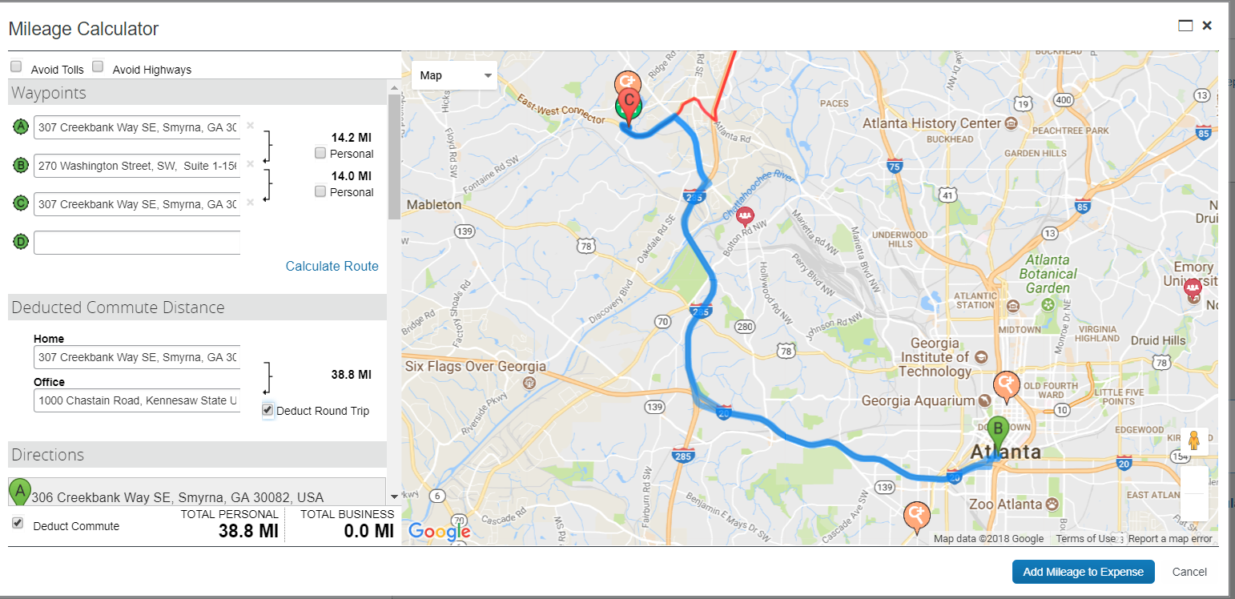
Travel on a Work Day: - left from Home and returned to Home

Slide 44
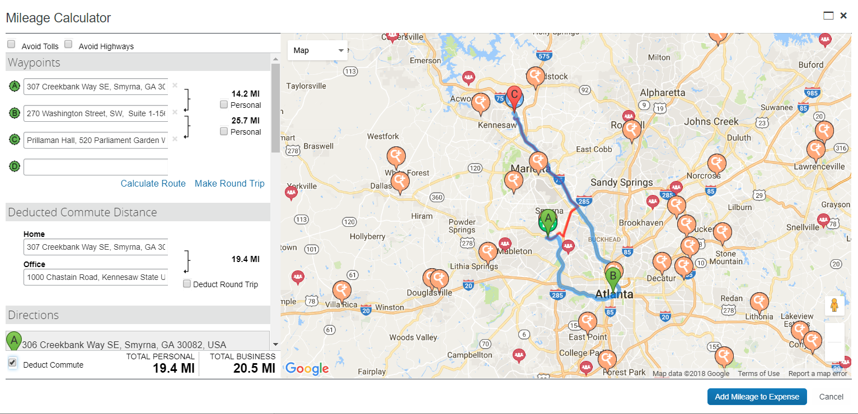
Travel on a Work Day: - left from Home, attended meeting, then drove to Campus

Slide 45
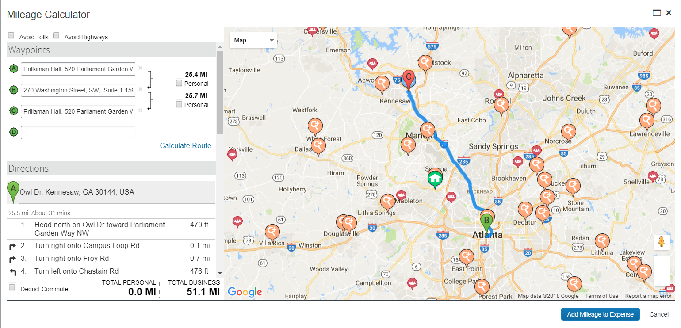
Travel on a Work Day: - left from Campus, attended meeting, then drove back to Campus

Slide 46
Exceptions to the Rule! No Commute Deductions Required
Travel completed on Saturday or Sunday
Travel completed on a Holiday
Part-Time Faculty & Staff are exempt
Travel completed during official Campus closing* (i.e. Winter Break)
*Spring Break doesn’t count!

Slide 47
New BOR policy effective July 1, 2018
Single Day Meal Per Diem
USG employees can no longer claim meals for non-overnight travel (single day).

Slide 48
Please remember to add
Stephanie Vaughn
to the approval flow for ALL travel requests and expense reports in Concur.

Slide 49
Expense reports should be submitted within 10 days, but no later than 45 calendar days after completion of the trip or event.
IRS regulations require employees to submit travel expense reimbursement requests within 60 calendar days after completion of the trip. Expenses submitted more than 60 calendar days after completion of the trip or event, if reimbursed, will become taxable income to the employee and will be reported on the employee’s Form W-2.

Slide 50
Questions?
Stephanie Vaughn
svaugh41@kennesaw.edu
470-578-2433
Office Location: Prillaman Hall, Room 4104

